Slide 1
Lecture 23: Intensity
Incoherent Sources: If the phase difference between the waves emitted by the sources varies randomly then the sources are called incoherent sources.
Coherent Sources: If the phase difference between the waves emitted by the sources remains constant then the sources are called coherent sources.

Slide 2


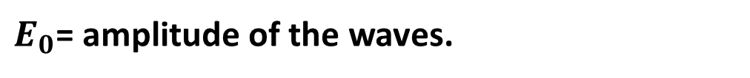

Intensity in Double-Slit Interference:
Let us assume, at point P the electric field components of the waves from the two slits are
$$E_{1}=E_{0} sin ωt$$
$$E_{2}=E_{0} sin (ωt+φ)$$
Where, $ω$= angular frequency of the waves.
$φ$= phase difference between the waves.
$E_{0}$= amplitude of the waves.

Slide 3
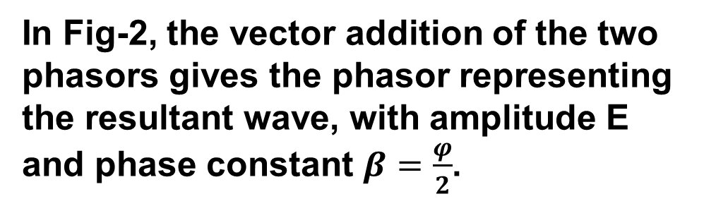
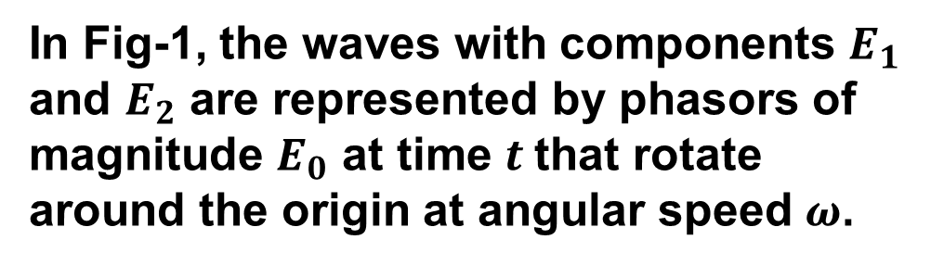
In Fig-1, the waves with components $E_{1}$ and $E_{2}$ are represented by phasors of magnitude $E_{0}$ at time $t$that rotate around the origin at angular speed $ω$.
Fig-1
In Fig-2, the vector addition of the two phasors gives the phasor representing the resultant wave, with amplitude E and phase constant $β=\frac{φ}{2}$.
Fig-2

Slide 4

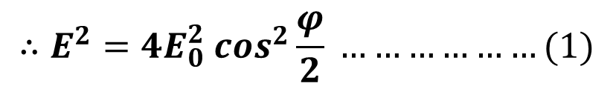
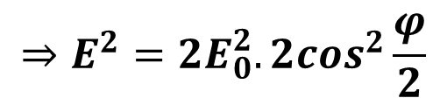

$$E^{2}=E_{0}^{2}+E_{0}^{2}+2E_{0}.E_{0}cosφ$$
$$⇒E^{2}=2E_{0}^{2}+2E_{0}^{2} cosφ$$
$$⇒E^{2}=2E_{0}^{2}(1+cosφ)$$
$$⇒E^{2}=2E_{0}^{2}.2\cos^{2}\frac{φ}{2}$$
$$∴E^{2}=4E_{0}^{2} \cos^{2}\frac{φ}{2} ………………(1)$$

Slide 5
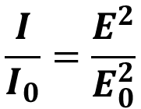
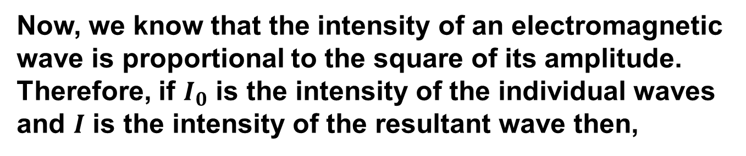
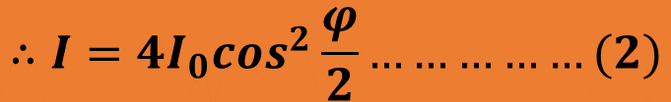
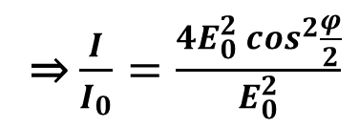
Now, we know that the intensity of an electromagnetic wave is proportional to the square of its amplitude. Therefore, if $I_{0}$ is the intensity of the individual waves and $I$ is the intensity of the resultant wave then,
$$\frac{I}{I_{0}}=\frac{E^{2}}{E_{0}^{2}}$$
⇒ $\frac{I}{I_{0}}=\frac{4E_{0}^{2} \cos^{2}\frac{φ}{2}}{E_{0}^{2}}$
$$∴I=4I_{0}\cos^{2}\frac{φ}{2}……………(2)$$

Slide 6
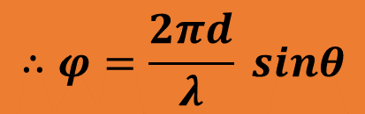
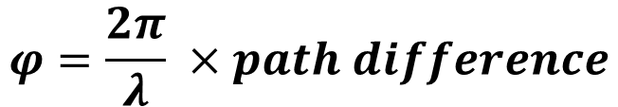
Again the phase difference,
$$φ=\frac{2π}{λ} ×path difference$$
$$∴φ=\frac{2πd}{λ} sinθ$$

Slide 7

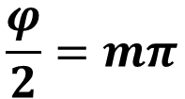
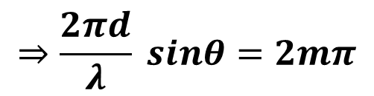
Condition for Intensity Maxima and Minima
From equation (2), we can see that intensity maxima will occur when,
$$\frac{φ}{2}=mπ$$
$$⇒φ=2mπ$$
$$⇒\frac{2πd}{λ} sinθ=2mπ$$
$$∴ dsinθ=mλ [m=0,1,2,3,….]$$

Slide 8
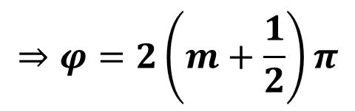
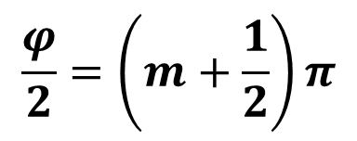
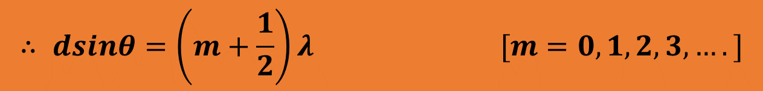
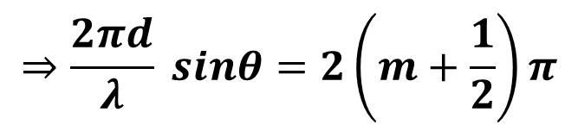
Again the intensity minima will occur when,
$$\frac{φ}{2}=\left(m+\frac{1}{2}\right)π$$
$$⇒φ=2\left(m+\frac{1}{2}\right)π$$
$$⇒\frac{2πd}{λ} sinθ=2\left(m+\frac{1}{2}\right)π$$
$$∴ dsinθ=\left(m+\frac{1}{2}\right)λ [m=0,1,2,3,….]$$

Slide 9
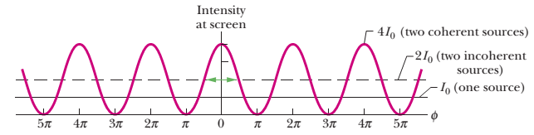

Slide 10
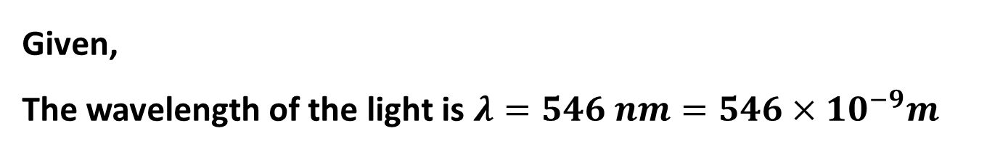
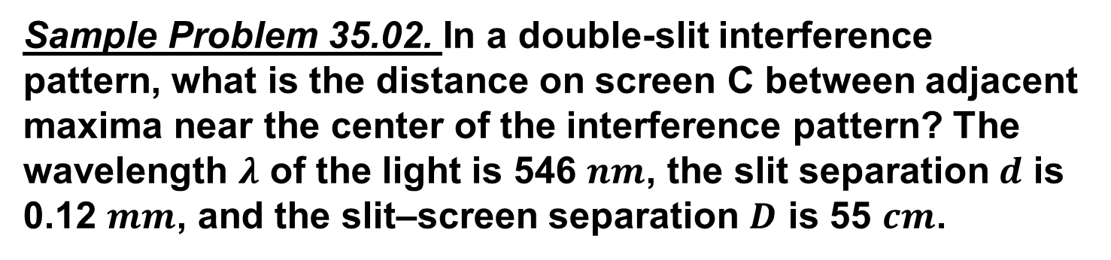
Sample Problem 35.02. In a double-slit interference pattern, what is the distance on screen C between adjacent maxima near the center of the interference pattern? The wavelength $λ$ of the light is 546 $nm$, the slit separation $d$ is 0.12 $mm$, and the slit–screen separation $D$ is 55 $cm$.
Given,
The wavelength of the light is $λ=546 nm=546×{10}^{−9}m$
The slit separation $d= 0.12 mm=0.12×{10}^{−3}m$
The slit–screen separation $D=$ $55$ $cm=0.55m$

Slide 11

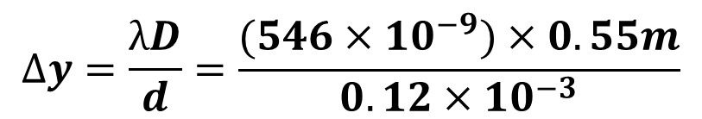

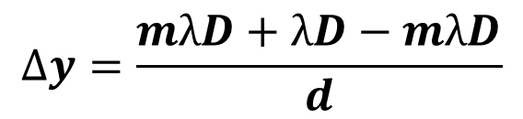
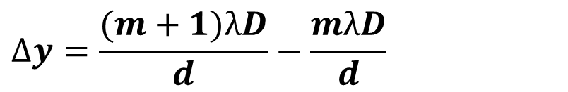

The position of the $mth$ maxima, $y_{m}=\frac{mλD}{d}$
And the position of the next maxima, $y_{m+1}=\frac{(m+1)λD}{d}$
So, the distance between the adjacent maxima,
$$∆y=Y_{m+1}−Y_{m}$$
$$∆y=\frac{(m+1)λD}{d}−\frac{mλD}{d}$$
$$∆y=\frac{mλD+λD−mλD}{d}$$
$$∆y=\frac{λD}{d}=\frac{(546×{10}^{−9})×0.55m}{0.12×{10}^{−3}}$$
$$∴∆y=2.50×{10}^{−3}m$$

Slide 12
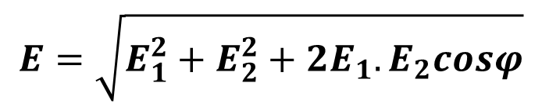
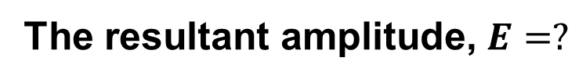


29. Two waves of the same frequency have amplitudes 1.00 and 2.00. They interfere at a point where their phase difference is 60.0°. What is the resultant amplitude?
Given: The amplitude of the waves, E1 = 1 and E2 =2
Phase difference = 60.0°.
The resultant amplitude, $E=?$
$$E=\sqrt{E_{1}^{2}+E_{2}^{2}+2E_{1}.E_{2}cosφ}$$
$$⇒E=\sqrt{1^{2}+2^{2}+2.1.2 cos {60}^{0}}$$
$$∴E=2.65$$

Slide 13
Note: The following slides are the intensity theory without phasor. Now it is your choice to follow one of them.

Slide 14


35-3: Intensity in Double-Slit Interference
bright fringe: d sin$θ$ = m$λ$for m = 0, 1, 2, 3 . . .
dark fringe: d sin$θ$ = (m + $\frac{1}{2}$) $λ$for m = 0, 1, 2, 3 . . .
These two equations tell how to locate the maxima and minima of the double slit interference pattern on screen as a function of the angle.
Here we wish to derive an expression for the intensity of the fringes as a function of the angle. Suppose that the waves emerged from the slits are coherent sinusoidal plane waves. Electric field components of the light waves of point P are not in phase and vary with time as
$$E_{1}=E_{0} sin ωt$$
$$E_{2}=E_{0} sin (ωt+φ)$$
For simplicity, we have chosen the point P to be the origin
so that the kx dependence in the wave function is eliminated.

Slide 15


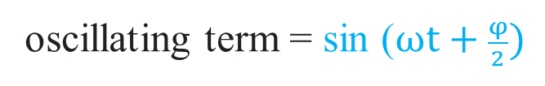

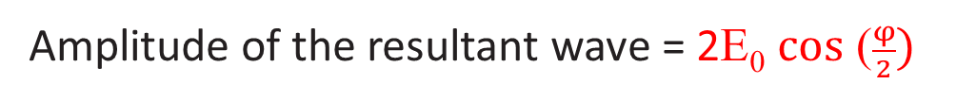

Resultant wave: superposition principle
$${E= E}_{1}+E_{2}$$
$$={E_{0} sin ωt+ E}_{0} sin (ωt+φ)$$
$$={E_{0} \{sin ωt+ }_{ }sin (ωt+φ)\}$$
$$={E_{0} \{sin ωt+ }_{ }sin (ωt+φ)\}$$
= E₀ {2 sin ( $\frac{ωt+ ωt+φ}{2}) \text{cos}\text{ (}\frac{ωt− ωt−φ}{2})\}$
= 2E₀ sin ( $\frac{2ωt+φ}{2}) \text{cos}\text{ (}\frac{−φ}{2})$
= 2E₀ sin ($ωt+\frac{φ}{2}) \text{cos}\text{ (}\frac{φ}{2})$
E = [2E₀ $\text{cos}\text{ (}\frac{φ}{2})]$sin ($ωt+\frac{φ}{2})$
Amplitude of the resultant wave = 2E₀ $\text{cos}\text{ (}\frac{φ}{2})$
oscillating term = sin ($ωt+\frac{φ}{2})$

Slide 16

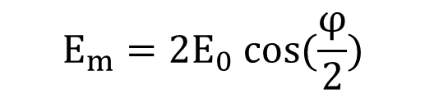
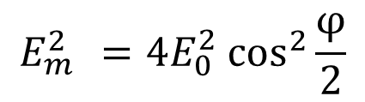


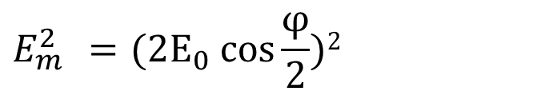

$$E_{m}=2E_{0} cos(\frac{φ}{2})$$
$$E_{m }^{2}=(2E_{0} cos\frac{φ}{2})2$$
$$E_{m }^{2}=4E_{0 }^{2}\cos^{2}\frac{φ}{2}$$
Intensity of an electromagnetic wave is proportional to the square of its amplitude.
The resultant wave with amplitude E_{m} has an intensity I that is proportional to $E_{m }^{2}$.
${I ∝E}_{m }^{2}$ $[resultant wave]$
$${I=kE}_{m }^{2} …………(1) [k=constant]$$
Each wave with amplitude E₀ has an intensity I₀ that is proportional to $E_{0 }^{2}$.
${I0 ∝E}_{0 }^{2}$ $[each wave]$
${I0=kE}_{0 }^{2}$ $…………..\left(2\right) [k=constant]$
(1) / (2)

Slide 17
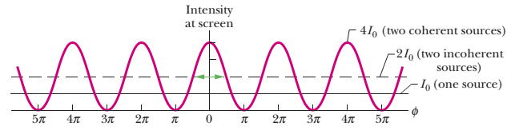

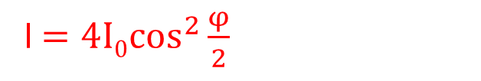

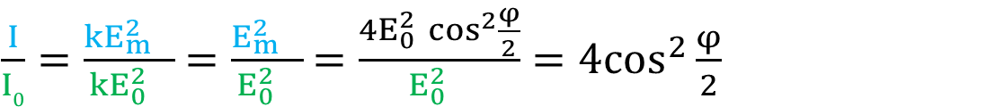

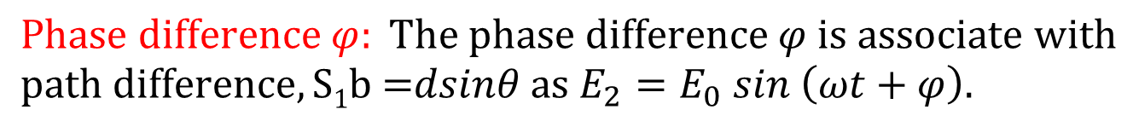

$\frac{I}{I0}=\frac{{kE}_{m }^{2}}{{kE}_{0 }^{2}}$ $=\frac{E_{m }^{2}}{E_{0 }^{2}}$ $=\frac{4E_{0 }^{2}\cos^{2}\frac{φ}{2}}{E_{0 }^{2}}=4\cos^{2}\frac{φ}{2}$
I$=4I0\cos^{2}\frac{φ}{2}$
$$Phase difference φ: The phase difference φ is associate with$$
$$path difference,S1\text{b}\text{ =}\text{dsin}\text{θ} as{ E}_{2}=E_{0} sin \left(ωt+φ\right).$$
If S₁b = $λ$, then $φ$= $2π$
$$\frac{φ}{S_{1}b}=\frac{2π}{λ}$$
$$\frac{φ}{dsinθ}=\frac{2π}{λ}$$
$$φ=\frac{2π}{λ}dsinθ$$

Slide 18
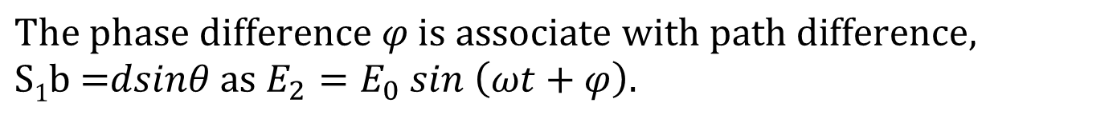




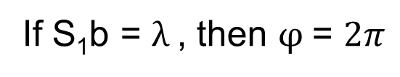
Phase difference $φ$:
$$The phase difference φ is associate with path difference,$$
$$S1\text{b}\text{ =}\text{dsin}\text{θ} as{ E}_{2}=E_{0} sin \left(ωt+φ\right).$$
If S₁b = $λ$, then $φ$= $2π$
$$\frac{φ}{S_{1}b}=\frac{2π}{λ}$$
$$\frac{φ}{dsinθ}=\frac{2π}{λ}$$
$$φ=\frac{2π}{λ}dsinθ$$

